Slide 1
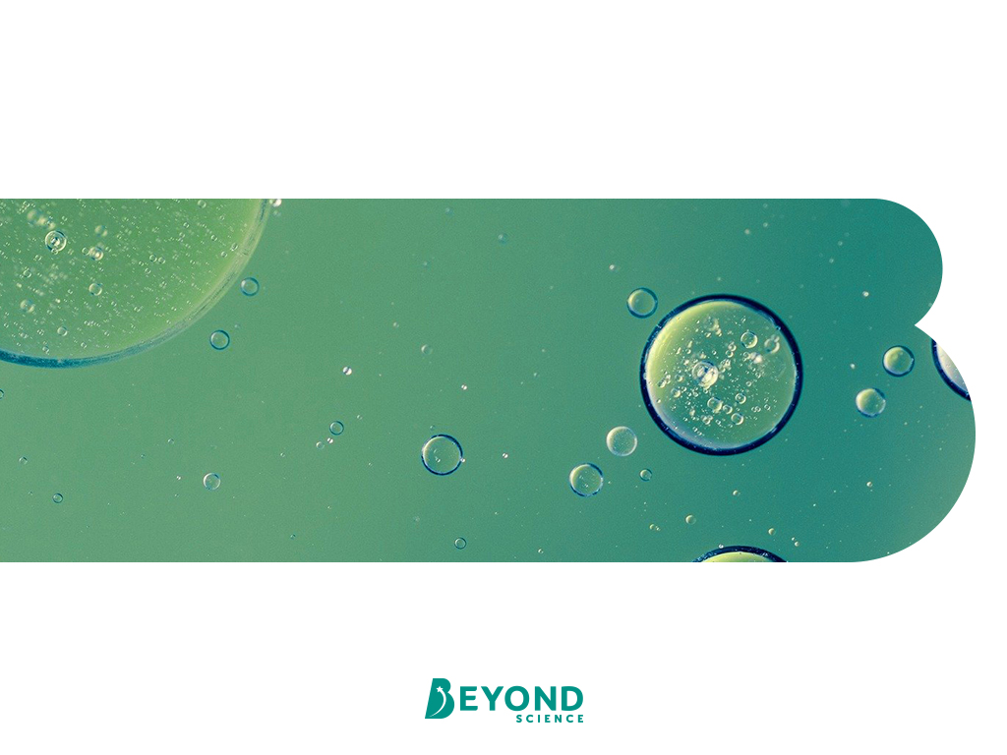
Cells and Organisation Specialised Cells

Slide 2
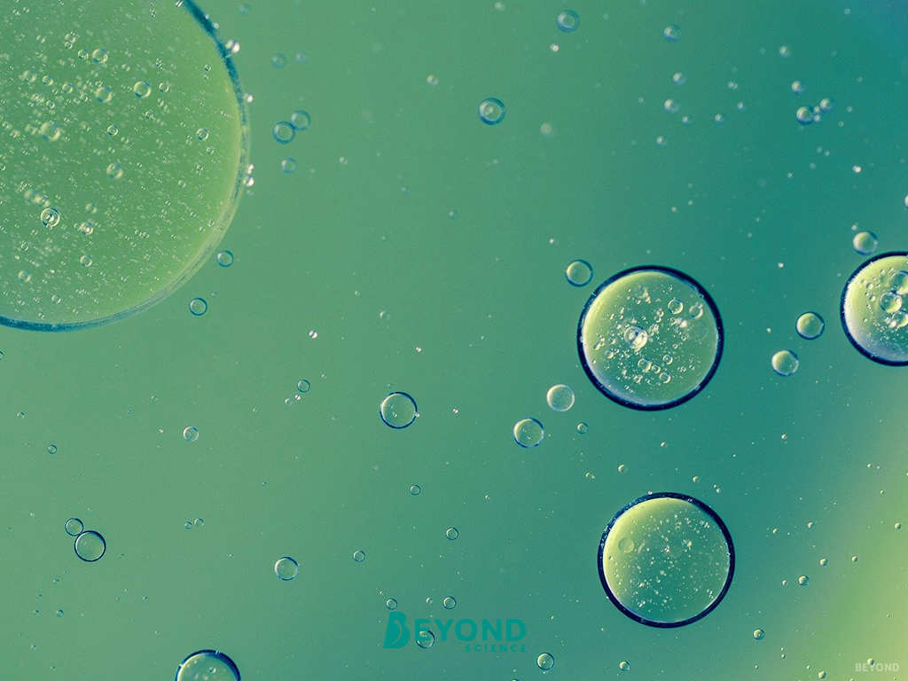
Learning Objective
To explain how cells are adapted for their functions.
Success Criteria
To identify specialised cells from both plants and animals.
To summarise the adaptations of specialised cells from both plants and animals.
To link the adaptations of specialised cells to their roles in the organism.

Slide 3
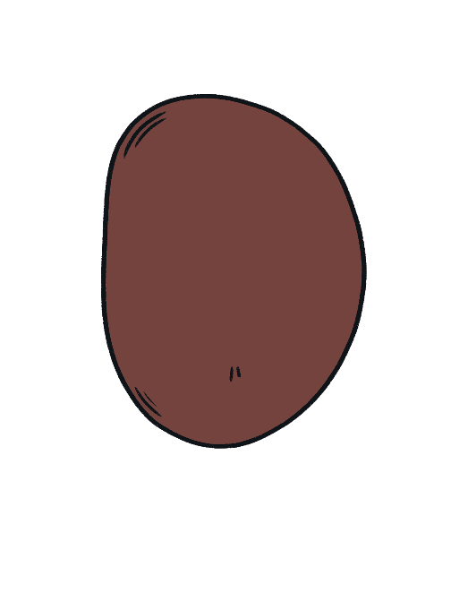
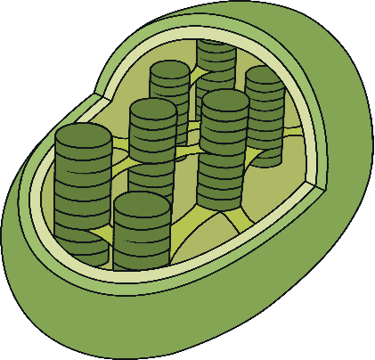
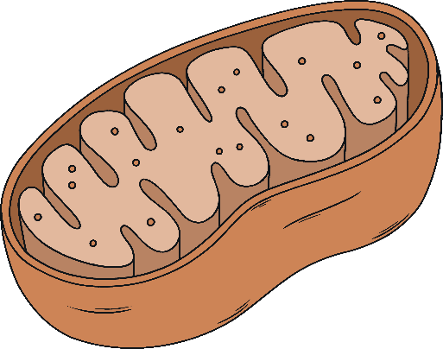
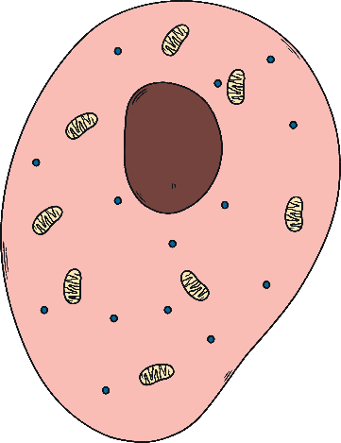
Cell Parts
There is only one of me in the cell.
I contain genetic information.
What am I?
I am found only in plant cells.
I contain a pigment that absorbs sunlight.
What am I?
nucleus
chloroplast
There are usually lots of me in a cell.
I help to provide the cell with energy.
What am I?
I am a jelly-like substance.
I am where chemical reactions happen.
What am I?
mitochondria
cytoplasm

Slide 4
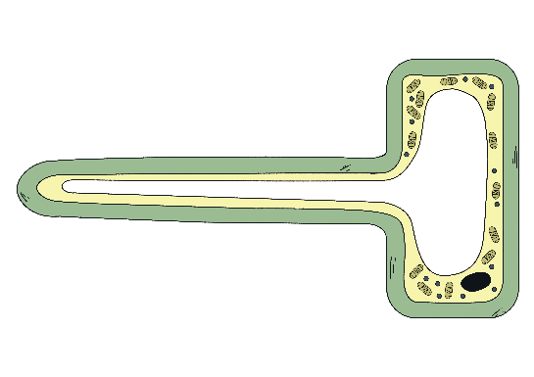

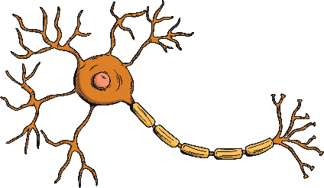
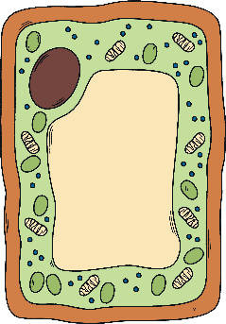
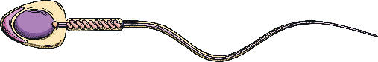
Specialised Cells Treasure Hunt
There are lots of jobs that need doing in an organism, and so there are lots of types of cells.
Each cell is specialised, which means its adapted so that it can carry out its job really well.
The adaptations can mean the cells can look quite different from the typical animal and plant cells we have already looked at.
There are information cards around the room that contain either adaptations, or functions, that the cells have to do. Find them, and see if you can use the pictures on your sheet to write them in the correct box.

Slide 5
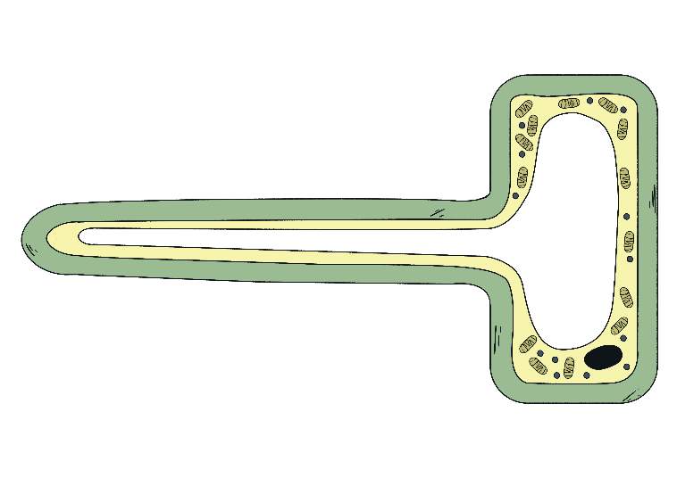
Root Hair Cell
What is its function?
To absorb water and minerals from the soil.
How is it adapted to this function?
Long root hair shape to fit between grains of soil so that it can reach water.
Large surface area for diffusion of water and minerals into the cell.
No chloroplasts due to being underground.

Slide 6
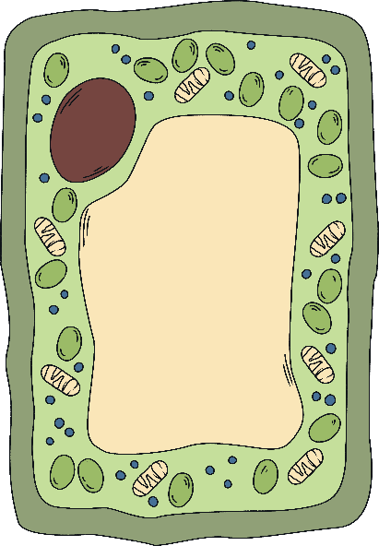
Palisade Cell
What is its function?
To carry out photosynthesis and make food (glucose) for the plant.
How is it adapted to this function?
Lots of chloroplasts to absorb light to provide energy for photosynthesis.
Tall, long shape and a large surface area to maximise the absorption of light.

Slide 7

Sperm Cell
What is its function?
To travel to and fuse with an egg cell for fertilisation.
How is it adapted to this function?
Long tail for movement to the egg.
Lots of mitochondria to release energy to allow the sperm to move the tail.

Slide 8
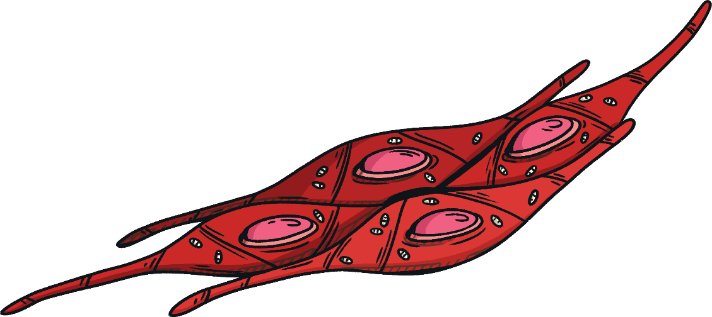
Muscle Cell
What is its function?
To help the body to move.
How is it adapted to this function?
Contains bands of protein that change shape to contract and relax the muscle.
Contains lots of mitochondria to provide energy for muscle contraction.

Slide 9

Nerve Cell
What is its function?
To carry nerve impulses around the body.
How is it adapted to this function?
Long fibres allow it to carry electrical impulses up and down the body.
Branching dendrites at each end to connect to other nerves or muscles.

Slide 10
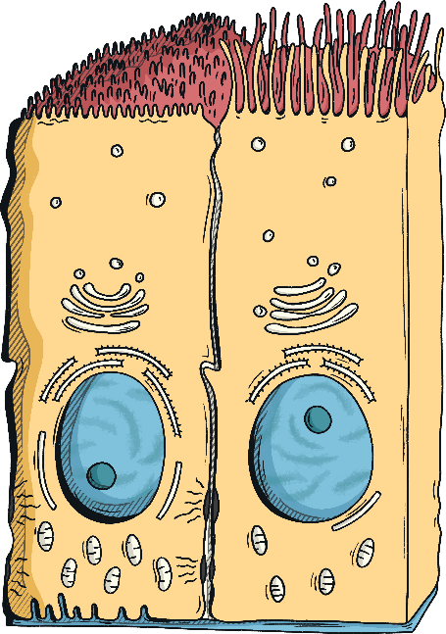
Ciliated Epithelial Cell
What is its function?
To move mucus with trapped dust and microorganisms away from the lungs.
How is it adapted to this function?
Tiny hairs called cilia to help to waft the mucus along the airways.
Lots of mitochondria to release energy for cilia to move.

Slide 11

Red Blood Cell
What is its function?
To transport oxygen around the body.
How is it adapted to this function?
Biconcave shape increases the surface area for the diffusion of oxygen.
No nucleus so that there is more room for haemoglobin, which binds to oxygen molecules.

Slide 12
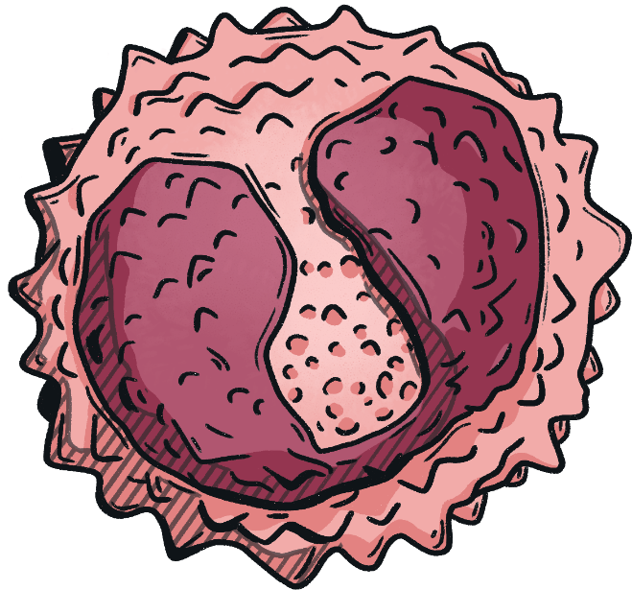
White Blood Cell
What is its function?
To fight pathogens which cause disease.
How is it adapted to this function?
Some can change shape to squeeze out of blood vessels and engulf pathogens.
Some can produce antibodies and antitoxins.

Slide 13
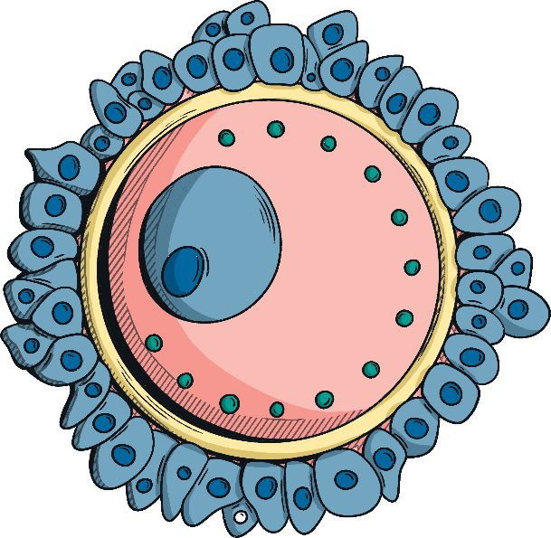
Egg Cell
What is its function?
To be fertilised by the sperm cell.
How is it adapted to this function?
Cytoplasm contains nutrients for the developing embryo.
The membrane changes after fertilisation to stop any more sperm getting in.

Slide 14

Extended Writing
For one specialised plant cell and one specialised animal cell, write a detailed paragraph that explains how the cell is adapted for its function.
The cell is a (plant/animal) cell.
It’s role in the organism is
It is adapted to do this role by
Another adaptation it has is

Slide 15
Design a Specialised Cell
Choose one of the cells below and have a go at designing it yourself.
You need to think about what its role in the body is and then decide what adaptations you think it will need to be able to do that job.
You could draw and label a diagram, or you could write a description, whatever suits you best!
skin cell
bone cell
fat cell

Slide 16
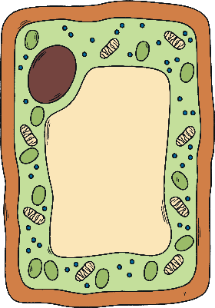

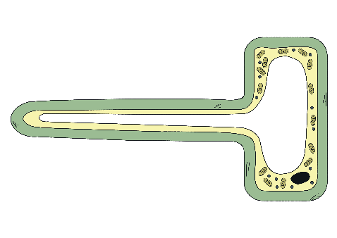




Splat!
A cell that absorbs water.

Slide 17
Splat!
A cell that has lots of mitochondria.

Slide 18
Splat!
A plant cell that has no chloroplasts.

Slide 19
Splat!
A cell that needs a large surface area.

Slide 20
Splat!
A cell that can contract.

Slide 21
Splat!
A cell without a nucleus.

Slide 22
Splat!
A cell that you’d find in your airways.

Slide 23
Splat!
A cell that transports oxygen.

Slide 24
Splat!
A cell that transports oxygen.

